Slide 1
Natural Language Processing
Session 8: Vector Semantics
Instructor: Dr.Nadia Saeed
Spring 2026,
Quaid-I-Azam University

Slide 2
Words and Vectors

Slide 3
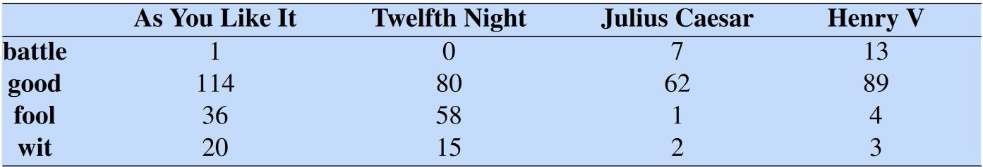
Term-Document Matrix
In a term-document matrix, each row represents a word in the vocabulary and each column represents a document from some collection of documents
Small selection from a term-document matrix showing the occurrence of four words in four plays by Shakespeare
The term-document matrix was first defined as part of the vector pace model of information retrieval (Salton, 1971)

Slide 4
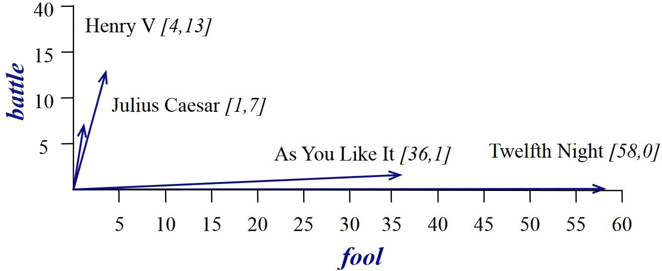
Documents as Vectors
Each document is represented by a vector of words
Comedies have more fools and wit and fewer battles

Slide 5
Words as Vectors
The word vector is a row vector rather than a column vector
The four dimensions of the vector for fool, wit, battle, good
Each entry in the vector thus represents the counts of the word’s occurrence in the document corresponding to that dimension
battle is "the kind of word that occurs in history documents (Julius Caesar and Henry V)" fool is "the kind of word that occurs in comedies, especially Twelfth Night"

Slide 6
Word-Word Matrix
Rather than the term-document matrix, we use the term-term matrix, more commonly called the word-word matrix (or the term-context matrix) in which the columns are labeled by words rather than documents
The matrix is |V|x|V| matrix and each cell records number of times the row (target) word and column (context) word co-occur in some context in some training corpus
The context could be the document, in which case the cell represents the number of times the two words appear in the same document
It is most common to use smaller contexts: generally a window around the word, for example of 4 words to left and 4 words to right, in which case the cell represents number of times column word occurs in such a ±4 word window around row word
Each row in word-word matrix is co-occurrence vector (context vector) of that row (target) word

Slide 7
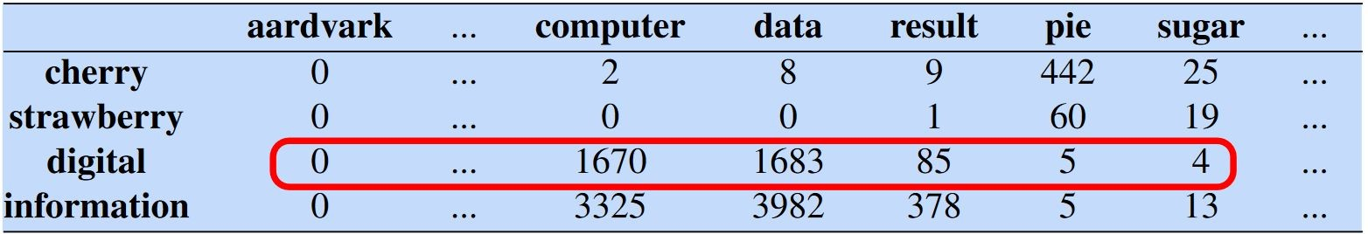
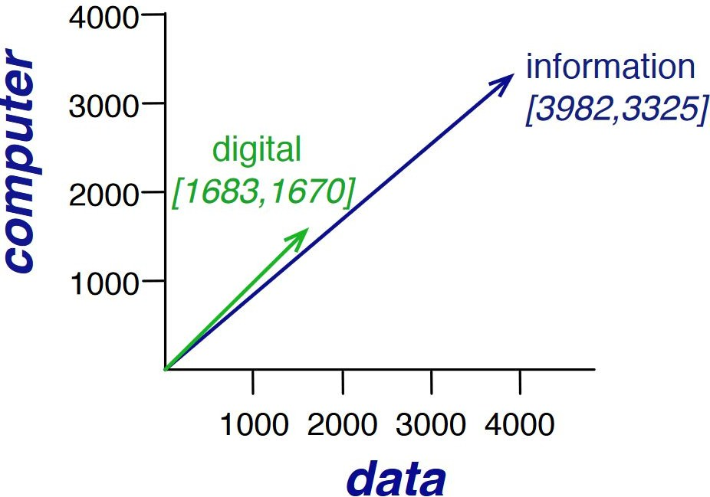
Word-Word Matrix: Example
Two words are similar in meaning if their context vectors are similar

Slide 8
Cosine Similarity

Slide 9

Euclidean Distance
)
Simple Idea
It tells how far apart two things are
Like measuring distance between two points on a map
In NLP
Words are turned into numbers (vectors)
Euclidean distance checks how similar words/documents are
Closer = more similar, farther = less similar
Example
cat & dog → small distance (similar)
cat & car → large distance (different)

Slide 10
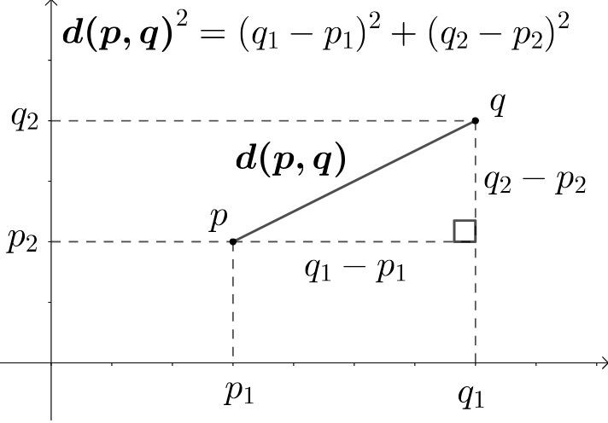
Euclidean Distance
Two-dimensional Example

Slide 11
Euclidean Distance
Natural
200
198
2
2.82
Language
2
Consider Query “Natural Language”
D1: “Natural Language”
D2: “Natural … Natural” (200 times)
Concatenate a document to itself

Slide 12
Euclidean Distance
Natural
200
Euclidean Distance
2
Language
2 200
Euclidean Distance is large for vectors of different lengths
Take a document d and append it to itself. Call this document dʹ
“Semantically” d and dʹ have the same content
The Euclidean distance between d and d’ can be quite large

Slide 13

Cosine Similarity
Cosine Similarity (NLP)
Intuition (Simple)
Measures how similar two vectors are in direction
Ignores length (document size)
Closer to 1 → very similar, 0 → not similar
Why it is useful in NLP
Compares meaning of texts, not word count size
Solves problem of long documents looking “far” in Euclidean distance
Applications
Document similarity (search engines)
Word embeddings (Word2Vec, GloVe)
Clustering similar texts
Recommendation systems
Simple idea 👉 “Same meaning = same direction, even if length is different”

Slide 14
Cosine Similarity
Natural
200
2
Language
2 200
The angle between the two documents is 0
Rank the documents by angle between term weight vectors Cosine correlation or Cosine Similarity

Slide 15
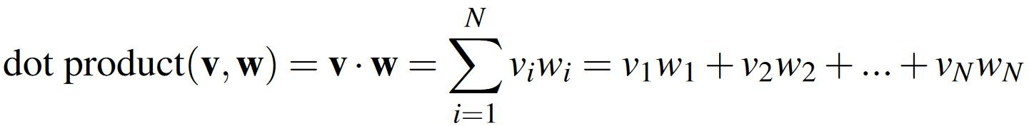
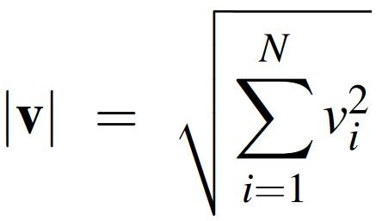
Dot Product and Cosine
The dot product between two vectors is a scalar
The dot product acts as a similarity metric because it will tend to be high just when the two vectors have large values in the same dimensions (good similarity metric)
Dot product favors long vectors – higher value for longer vectors Vector length:

Slide 16
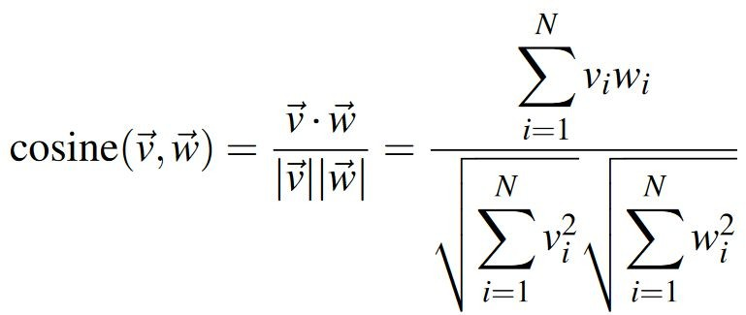
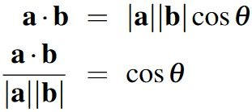
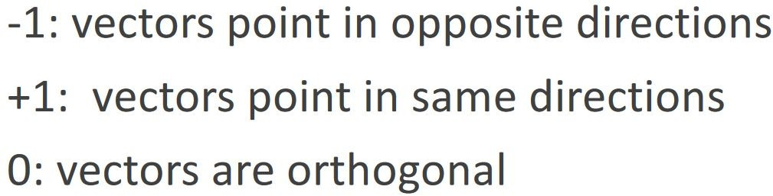
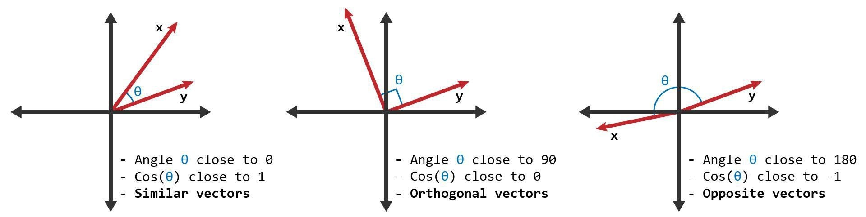
Cosine Similarity
Based on the definition of the dot product between two vectors a and b

Slide 17
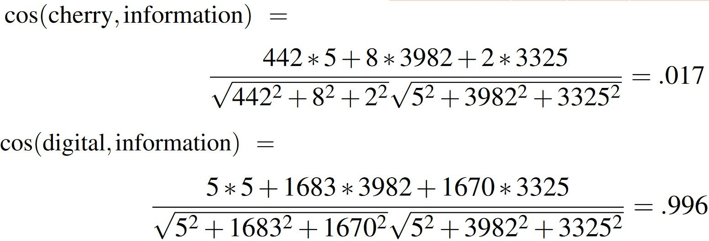
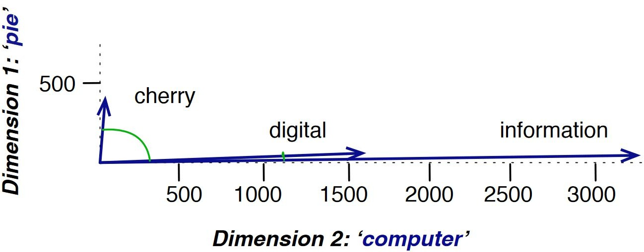
Cosine Example
 | pie | data | computer
cherry | 442 | 8 | 2
digital | 5 | 1683 | 1670
information | 5 | 3982 | 3325

Slide 18
An Issue
Although frequency is important, but simple frequency is not the best measure of association between words
Word that occur nearby frequently (maybe sugar often appears in our corpus near apricot) are more important than words that only appear once or twice
On the other hand, words that are too frequent such as the or a are unimportant How can we balance these two conflicting constraints?

